Slide 1
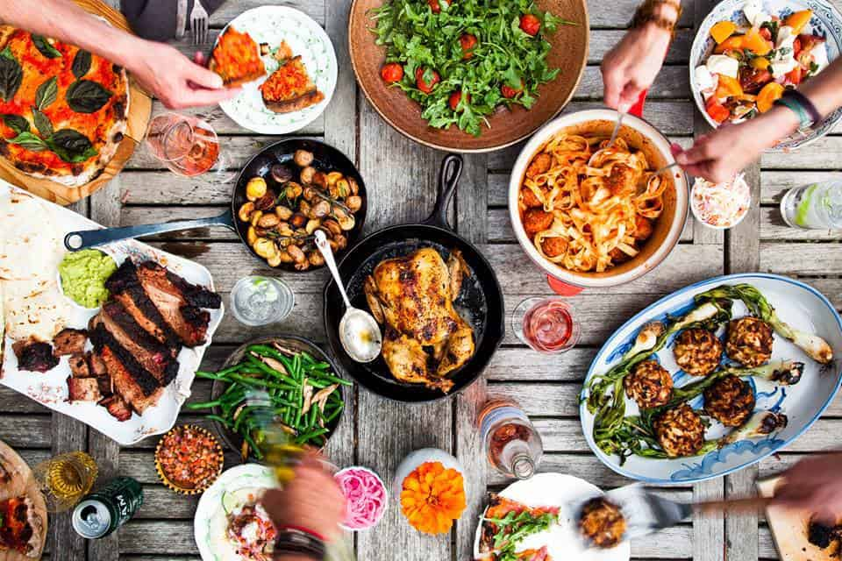
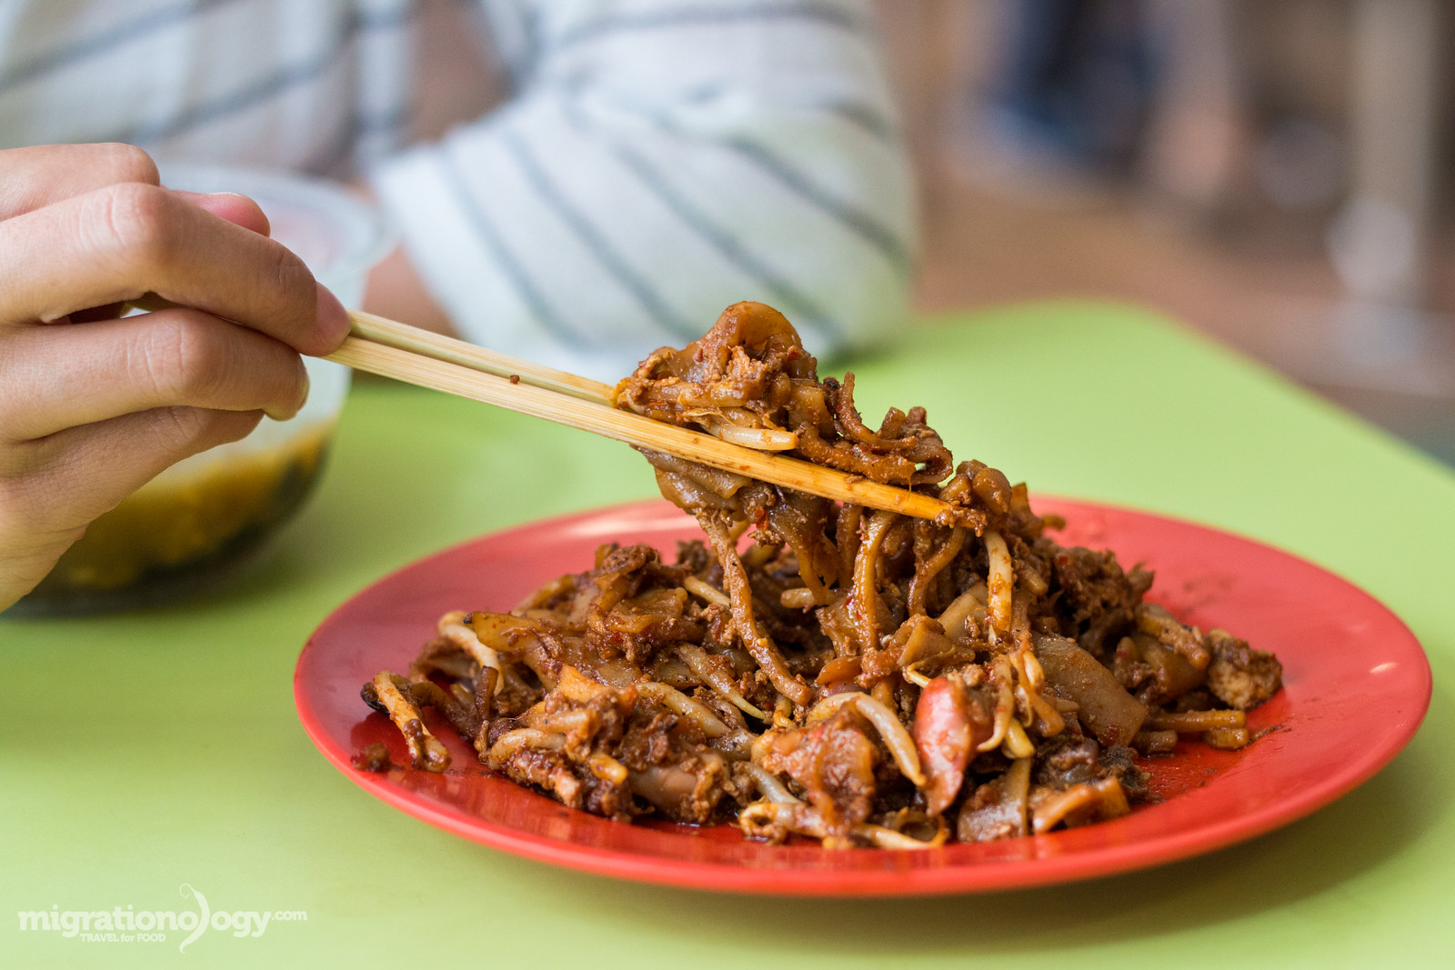
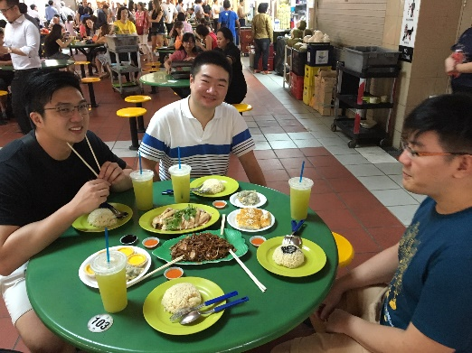
Graph-enabled Gourmet Experience
Recommender System
Zheng JunYi - Thia Wei Soon - Kelvin Tham - Geraldine Pang - Kevin Moe

Slide 2



Background
Singapore has a vibrant F&B scene.
Digital platforms have been developed to promote awareness of good eateries, allowing for customer inputs to shape consumer behavior and business processes.
HOW F&B PROFILES THEMSELVES
INTERACTION WITH CUSTOMERS
NEW OPPORTUNITIES TO LEVERAGE DATA

Slide 3




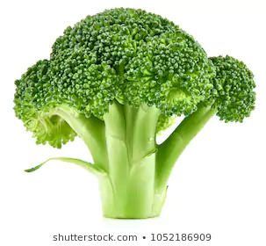
Background
Burpple is a food discovery platform that offers recommendations, deals and reservation functions.
Reviews provided through user comments on restaurants provide a wealth of information, but most of it may be under exploited.
?
Limited means to querying beyond restaurant names
No means for users to detect evolutions in food trends over time

Slide 4
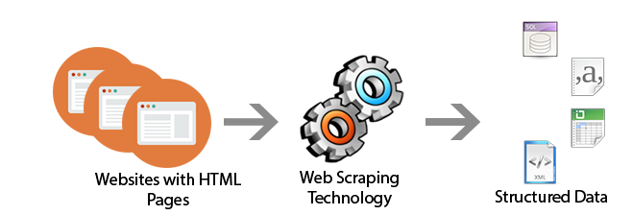
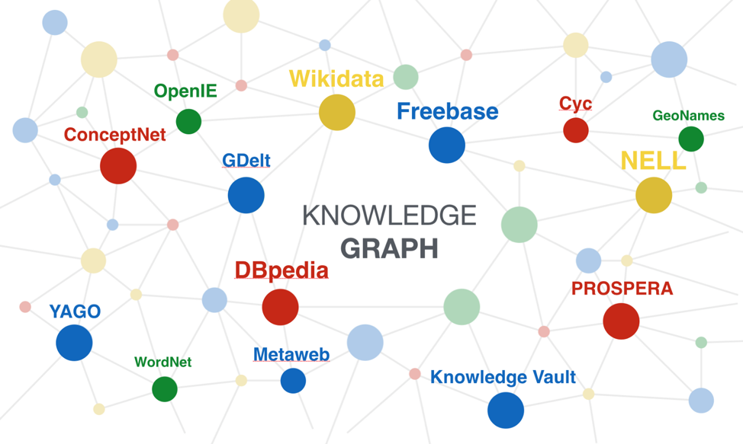
Project Objective
Fully exploit Burpple’s data to enhance their current offerings.
Approach: Web-scraping of Burpple’s pages → Construct Knowledge Graph

Slide 5
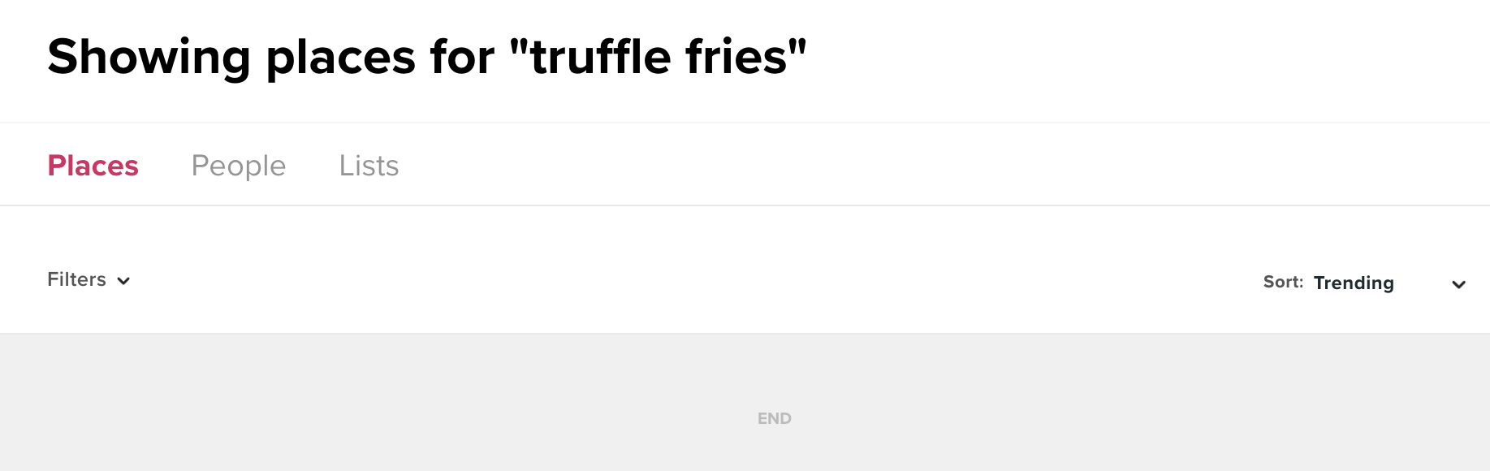

Deliverables
Project has 4 sub-deliverables
1
Basic
2
Basic
Demonstrate basic ability to make recommendations based on new reviews provided by a user.
Allow users to query food types directly, and extracting the restaurants that serve their food of interest.
“where can I find juicy broccoli”?

Slide 6


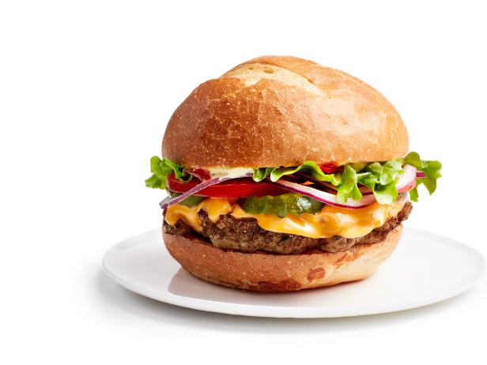
Deliverables
Project has 4 sub-deliverables
3
Advanced (time-permitting)
4
Advanced (time-permitting)
Provide ability to visualize developments in food trends over time e.g. Mala, bubble tea.
Predict restaurant cuisine type using the food being served. Some users provide cuisine labels/clues of the restaurant being reviewed, which can be used for supervised learning.
Western?
Japanese?
Italian?
time

Slide 7
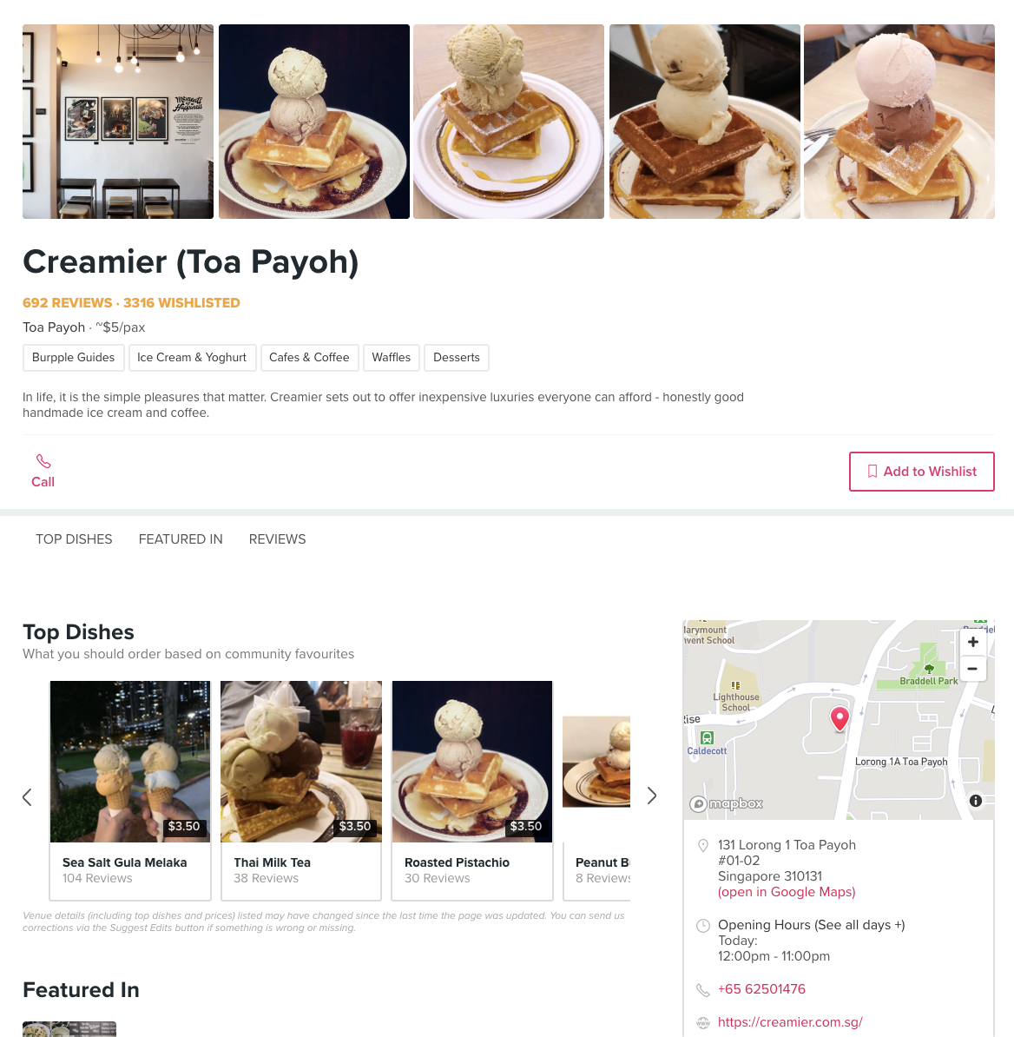
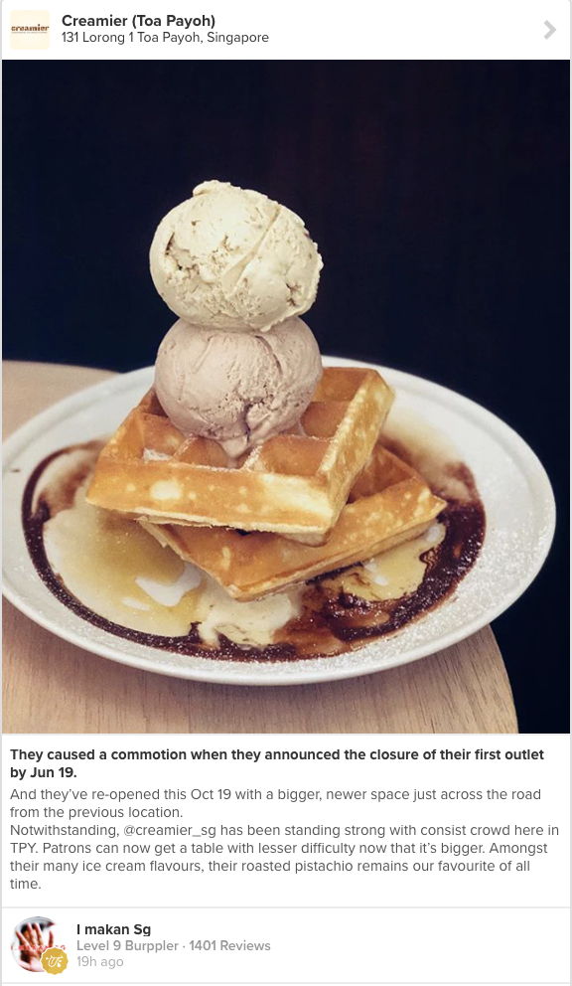
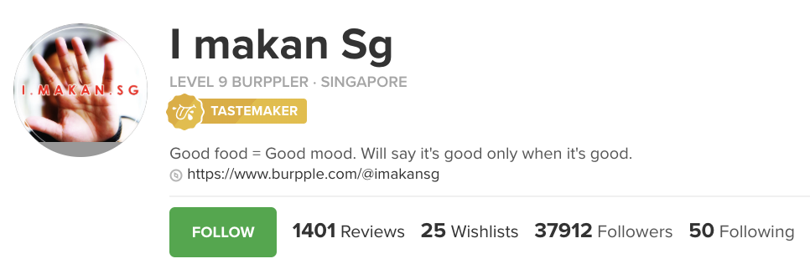
Data
Scraped from site: www.burpple.com
Users
Username
Badge
Level
Reviews
Number of Reviews, Wishlists, Lists and Following/Followed users
Reviews
Title
BodyText
Restaurant
Restaurants
Restaurant_Name
Food Categories
Restaurant_Location
Number of Reviews
Food
Notes:
Data Issues:
Scraping beyond the first page without Selenium to automate the clicking of “load more” button.

Slide 8
Data
Example of Burpple Reviews: Scraped and Generated data
Title | BodyText | Restaurant | Location | Date | User | Food tags + Sentiment | Restaurant Tags | Year | Overall Sentiment
Wonda-fu | The double espresso(?)-based drink was pleasantly light … | Two Cranes | 211 Hougang Street 21, Singapore | 6d ago | @z***** | [(espresso,0.8)] | pleasantly light | 2019 | +0.9
Inaniwa Udon [$24.80] | … try their new inaniwa udon set that came with cold udon, mentsuyu, assorted tempura and kyabetsu salad...calm and inviting space…the lightly battered tempura were cleanly fried and not at all greasy. | Tenjin | 1 Scotts Road, Shaw Centre, Singapore | 4d ago | @c***** | [(tendon,0.99), (cold udon,0.97), [tempura,0.77), (salad,0.69)] | calm, inviting, fried, not greasy | 2019 | +0.9
Disclaimer: Generated data examples here are manually generated.
Notes:
Sentiment score: of the restaurant
Review tags: of the food item

Slide 9
Data
Example of Burpple Restaurants: Scraped and Generated data
Restaurant | Category | Location | Number of Reviews | Food | Cuisine | Average Sentiment from Reviews
Two Cranes | Café & Coffees, Newly Opened | 211 Hougang Street 21, Singapore | 12 | Eggs Benedict, Chicken Strew, Yuzu Cold Brew Cream | Western, Café, Coffee, Brunch | 0.76
Tenjin | Japanese | 1 Scotts Road, Shaw Centre, Singapore | 13 | Tendon, Tempura | Japanese | 0.87
Disclaimer: Generated data examples here are manually generated.
Notes:
Sentiment score: of the restaurant
Review tags: of the food item

Slide 10


About
Review 1
Restaurant A
Wrote
About
Served by
Review 2
Contains
Food1_A
Served by
Wrote
About
Wrote
Contains
Review 3
Food2_A
Wrote
Overall Sentiment
Features: quiet, clean, good service
Review 4
Restaurant B
About
Food category
Location
Served by
Food Sentiment
Features: spicy, juicy, delicious
Contains
Food1_B
Contains
Review 5
Food name
Wrote
Restaurant C
Wrote
About
Review 6
Contains
Attributes
Served by
Food1_C
Links
Recommendations

Slide 11
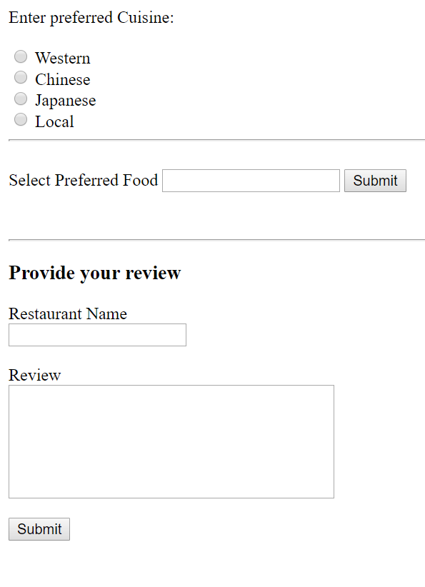
Expected Outcome…
You may like: Mala, Salted Egg
RESTAURANT NAME
Popular Dishes
Top Reviews
Average Rating (Sentiment Score)

Slide 12
Workflow
Integration
Scraping
NLP / IE
Create UI
Extract food, restaurant and sentiment info
Parse Query
Scrape Data from Burpple
Parse into JSON/DataFrame
Parse into Neo4J
OUTPUT
Data Formatting and Storage

Slide 13
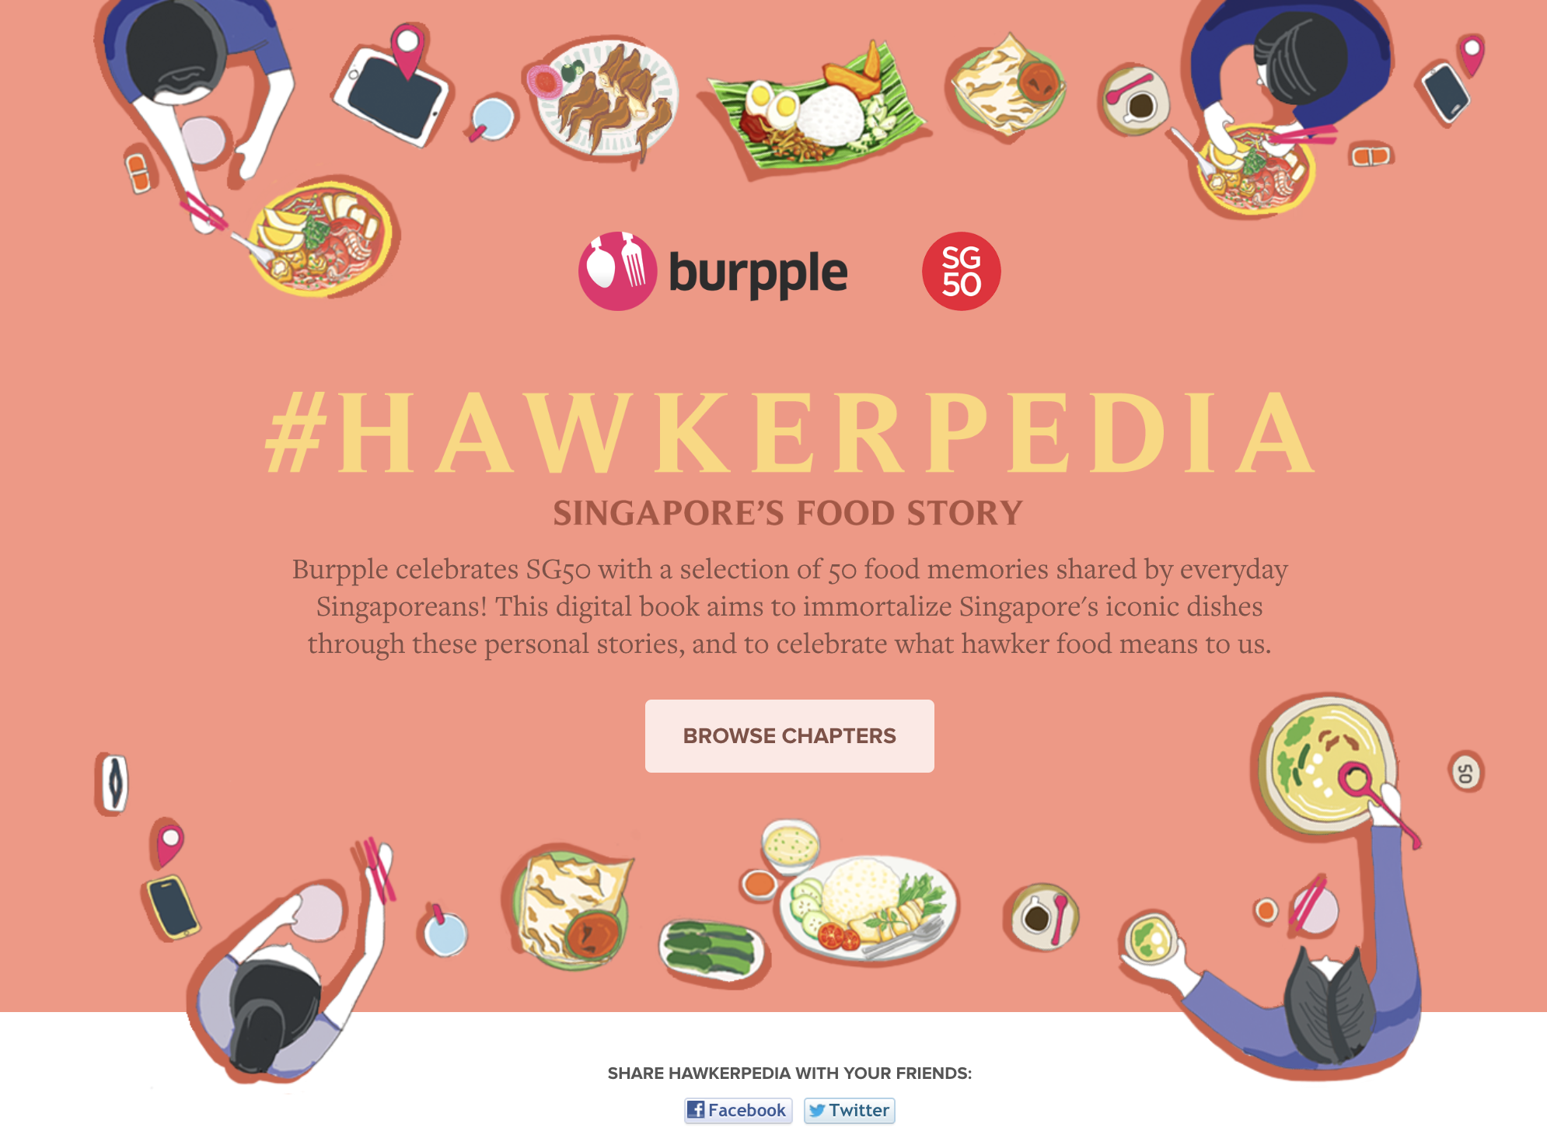
Thank you! ☺

